Slide 1
Models of logical control systems
based on microcontroller devices
Student: Maksym Hoha
Kharkiv 2019

Slide 2
The purpose and objectives of the project
The purpose of the certification work is a template for building a description of models of real-time systems using automatic and event programming technology, with the best way to describe time parameters.
To achieve this goal it is necessary to solve the following tasks:
to analyze the methods of designing logical control systems;
to analyze the methods of designing real-time systems;
to carry out the analysis of methods of automatic programming at construction of models of time automata on the basis of the microcontroller;
to analyze the principle of building an event handling and interrupt system;
create a software implementation of the device for all the characteristics of logical control systems and real-time systems;
analyze the disadvantages and advantages of the created software implementation.
Notes:
Based on the general concept of building automated control systems, they can always be distinguished control devices and control objects. Among all the set of control devices can be distinguished logic control devices, in which control signals (control value) are represented in binary alphabet. To implement the control part in such devices, as a rule, use the ultimate control devices (CD). Such devices are widely used in Internet of Things systems.
Any local digital device that implements an algorithm for information processing or control can be implemented in two ways: hardware or software-hardware .
In the software-hardware implementation method, the algorithm is described in a hardware-oriented programming language (for example, in C language with special libraries), taking into account the hardware architecture on which the given program will be implemented. These are usually different families of microcontrollers (MCUs). The advantage of this approach is the availability of special hardware-oriented functions (timers of interrupt controllers), as well as the availability of hardware-implemented interfaces for exchange with external devices. Disadvantages include lower speed and limitations imposed by the hardware architecture on the implemented algorithm.

Slide 3
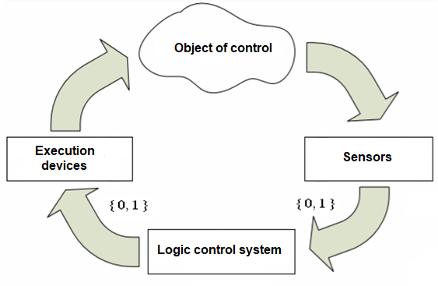
Logical control systems
Objects of control (OC) for logic control systems (LCS) are various control devices (fans, electric motors, lighting devices and many others).
Information about the operation of the OC comes to the LCS from position, status and parameters (sensors and sensors). Parameter signaling devices consist of two components - a sensor and a secondary device (converter), which compares the values of the analog signal from the sensor with the specified parameter values, and the formation of a binary signal {0, 1}. Thus "0" is defined by an exit of value out of the established ranges, and "1" by finding of value of parameter in the set range.
LCS affect the OC not directly, but through actuators - magnetic starters, electromechanical transducers, hydromechanical transducers, pressure regulators, thermostats and more. Therefore, when building such systems, it is assumed that they are part of the OC.
The general structure of the automatic control system
Notes:
One of the classes of automatic control systems are logic control systems (LCS). The specificity of LCS is that they have input signals X and output signals Y can take only two values - 0 and 1.
At the heart of models of logical control systems is the concept of "state".
The state is a set of parameters of the technical system at a given time. The current state carries all the information about the past of the system, necessary to determine its response to any input action that is formed at a given time.

Slide 4
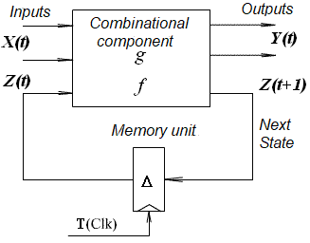




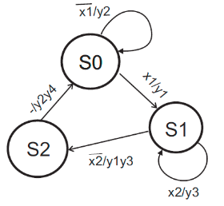
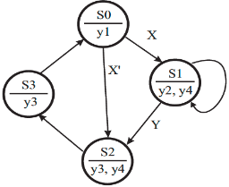
Кінцеві автомати
Візуальний формалізм автоматів
Output function Transition function Change of states Expanded f
Structural Automaton Model (Huffman Model)
One of the advantages of transition graphs, which should be "maximally" plenary, is that each of its arcs does not indicate all the input signals, but only those of them that provide a transition in this arc.
Each state in the transition column "selects" from the set of all input actions only that subset of them that provides transitions from this state.
Ensuring "parallelism" in the outputs is achieved by indicating in the components (in vertices and / or arcs) of the graph of the transitions of the values of the output variables (activities) formed in these components
Examples of the transition graph
Notes:
Structural models of automata used in logical control problems can be considered as control devices. An important characteristic of the logical control system is its finiteness. The control machine not only has a finite number of states, but also the functions of transitions and outputs implemented by it operate exclusively with finite sets of signals. This property allows to describe logic of behavior of automatic machines explicitly in the form of tables or graphs of transitions.

Slide 5
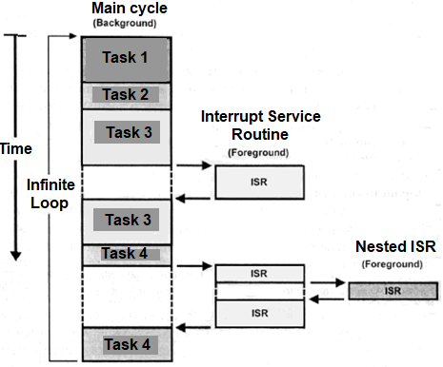
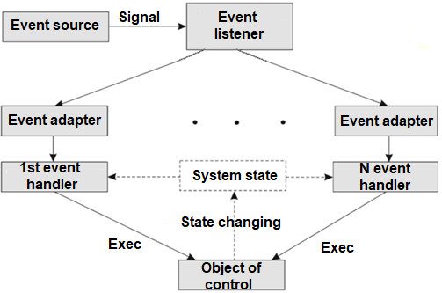
Event handling in control systems
Event-based programming model
Execution of the program
with nesting interrupts
Notes:
In many logical control systems, control is performed exclusively by external events.
/ * About events * / / * What and how is implemented by the system and the developer * /
/ * How to handle an event? * /

Slide 6
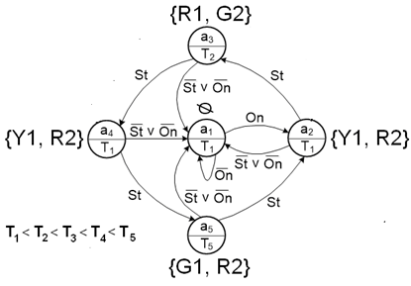










Real time systems. Time machines.
Алфавіт моделі структурного часового автомату
The set of input variables (set
alerts from the object
control and set of external events)
The set of output variables (set
control signals and output functions)
The set of internal variables that determine the encoding of the states of the machine
Transition function
Output function
Examples of the time machine visual formalism
The initial state code of the machine
The set of time variables for constraints on each arc of the transition graph, where p is the number of arcs in the transition graph. The time variable has a range [1: infinity], where infinity corresponds exclusively to the event function of transitions
The set of time variables for the timeouts (expected) of each state of the automaton, where n is the number of states of the automaton
The set of delays for the implementation of the corresponding output signal, where m is the number of output variables
Notes:
Real-time management system (RMS) - a system in which the resulting action (activity) depends not only on the logical values ​​of simple control actions, but also on the time during which these actions are performed. The main difference between real-time tasks and time-independent tasks is that in real-time systems, the task must be completed within a specified period of time, which allows you to correctly complete the data processing process.
When describing the behavior of real-time control systems, it is necessary to take into account temporal aspects in their behavior. To do this, the finite state machine model is extended by introducing a time variable, and the concept of a time machine (timed automata, timed FSM) is introduced.
To describe the temporal aspects of the automatic model, usually three parameters are used: time constraints tc (timing constraints) - the imposition of certain conditions that can be analyzed at this time, but performed after its completion, (input) timeouts tto (timeouts) - in finite state machines it is accepted to consider time which should work of a condition and output delays td (output delays), sometimes called output timeouts - division of operating time of the same state.
In the general case, the time machine can contain all three time parameters, but for a specific task, time machines with one or two of these parameters can be used.

Slide 7
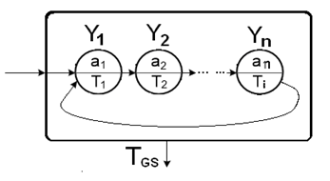



Hyperprocess. Hyperstates
Output function Transition function Hyperstate transition-output function
Principles of hyperstate construction
Graphic model of hyperprocess
in the graph of machine transitions
A hyperautomatic machine (hyperprocess) is a machine that contains hyperstanes.
Hyperstate - a state of hyperautomatics, the transitions between which are carried out unconditionally, taking into account only the time of existence of each of the states.
The states of the automaton, which are part of the hyperstate, are completely or partially looped.
The entrance to the hyperstate is always to the first state from the set of states of the hyperstate, regardless of which of the states of the main automaton is the transition to the hyperstan.
Exit from the hyperstate occurs either at the end of the existence of the hyperstate, or in the presence of "external" events (which are formed outside the set of output alerts of the machine), regardless of which of the hyperstate states the machine is at this time.
Hyperstan has no separate output variables, only the output variables of the main automaton are used.
The output variables of the main automaton can be used in hyperstane and vice versa. In the hyperstate the alarm signals of the main automaton can change, but the exit from the hyperstate is carried out either by a time parameter or by an external signal (event), which is not an alarm for any of the states of the automaton.
Notes:
When implementing real-time systems, there are often situations when the function is performed without having any input signals. Such functions are usually more than one and they are performed one after the other until their time of joint work expires. It should be noted that such states perform subfunctions of the main functional (a separate node of the device, which can not be separated).
The states of the automaton that are part of the hyperstate are displayed in the Moore model without input signals

Slide 8
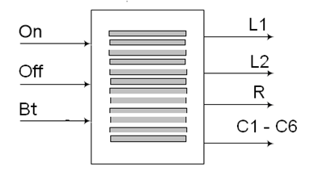
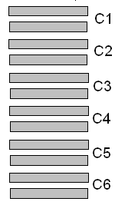

Automatic control device model
Control device interface
Example of pedestrian crossing lighting
Stripes
Set of input signals: X = {On, Off, Bt}, where On / Off = {0, 1} - signal on / off the pedestrian traffic light, Bt = {0, 1} - signal (event) of the button that initiates the main mode of illumination of crossing and illumination of its strips.
The set of output signals: L1 - signal to turn on the light button "Bt" when turning on the system, but no pedestrians, L2 - signal to turn on the main lighting of the entire transition spotlight on the pole, R - signal to turn off the red traffic light, C = {C1, C2, C3, C4, C5, C6} - a set of signals of the stripes pairs illumination.
Notes:
The pedestrian crossing lighting control system is taken as an example. The algorithm of operation of the pedestrian crossing lighting control device is as follows. The device is turned on by the switch only in the dark. The lights are switched on directly at the command of the pedestrian by pressing the pedestrian call sign button. After that, the exterior lighting of the crossing and the red light of the traffic light for vehicles light up. Time is given to prepare the pedestrian for the crossing, and the vehicle must leave the "zebra" of the crossing during this time. After that, the zebra stripes of the crossing, which accompanies the pedestrian at the crossing of the carriageway, begin to be illuminated. For the convenience of crossing the road on both sides, a counter-illumination of pairs of lanes of the transition to the middle of the road and back. The speed of illumination is calculated in such a way that allows pedestrians to cross the road freely and is regulated depending on the number of lanes. After that, the HTP button is locked for a time sufficient to ensure the free movement of traffic. The HTP button is pressed during the lock and is memorized, and the light switch-on event takes place after the lock time has elapsed. If the HTP button is not pressed during the lock, the device enters standby mode.
Physically illuminated transition strips can be realized either by suspended lamps that mimic transition strips, or by flooring the illuminated transition strips.
The software implementation of the device must be based on the principle of automatic programming and construction of an automatic template, taking into account all the features of the microcontroller base (event system / interrupt system and event / interrupt handling mechanisms) and taking into account that this system is a real-time system. automatic.

Slide 9


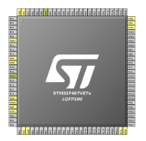

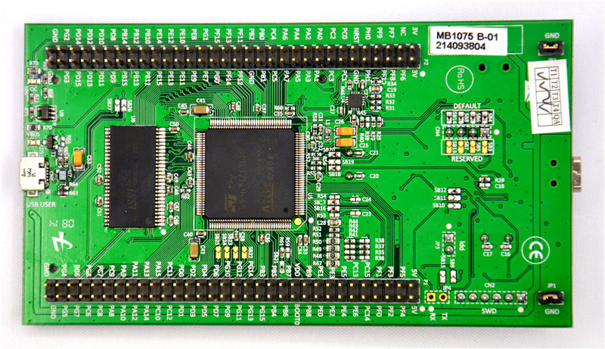

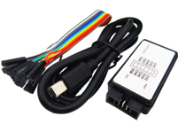
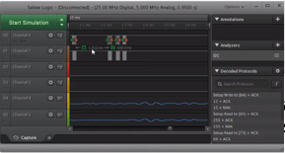
Hardware and software components of the control device implementation
STM32CubeMX CAD
The "heart" of the STM32F429I-DISC0 system
Keil for ARM IDE
Logic analyzer and debugging software
Notes:
To implement the device under development, it is necessary to coordinate all the necessary components of hardware and software implementation.
The hardware implementation uses a microcontroller F429ZIT6 family STM32, which is diluted on the board for the development of DISCO.
As a software implementation, CubeMX CAD is used to quickly build a framework in the form of code to describe the system with all the necessary system settings.
STM32CubeMX is a visual graphics editor for configuring microcontrollers of the STM32 family, which allows you to generate code based on the C language, using graphical assistants.
The generation of CodeMX code is rich in the choice of Integrated Development Environment (IDE). One of the most popular and modern among them is Keil for ARM (MDKARM5).
The main device description library is the Hardware Abstraction Layer (HAL) library.
This is a library for creating projects on STM32, developed by STMicroelectronics in 2014. HAL allows you to abstract from working with registers. Roughly speaking, HAL is a wrapper over low-level operations. Of course, this does not eliminate the need to understand the device of microcontrollers, but significantly reduces the level of entry.
An additional device that is not related to the implementation of the control device, but allows you to demonstrate the operation of the device in the form of signal display (timeform generation (waveform)) is used hardware signal monitoring device - logic analyzer Saleae 8 Logic.

Slide 10
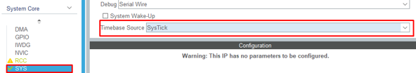
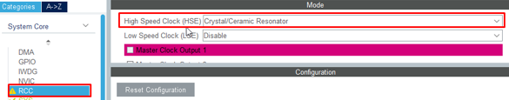
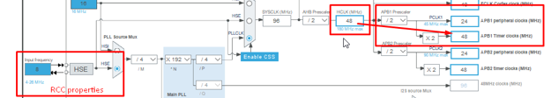
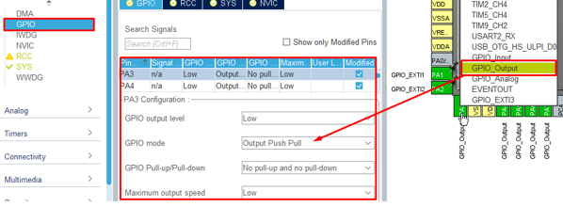
Required microcontroller settings
List of peripherals to connect and configure
System clock (SysTick)
Interrupt Timer (TIM)
I/O ports (GPIO)
Glock Generation System (RCC)
Interrupts (NVIC)
Notes:
Before starting the description, you need to configure all the peripherals that will be used.
1. SysTick. This is a feature that supports the work of the MC and the peripherals in general. Any changes and reconfiguration of SysTick can lead to uncontrolled operation of the MC, which will inevitably lead to unexpected consequences (hard fault, failure of the MC and peripherals, the transition of the MC to the protection state).
2. Interrupt timer (TIM3 and TIM4) must be connected to adjust the I / O port frequency
3. I / O peripherals (GPIO) must be connected
4. The interaction of the entire internal microcontroller system is due to the adjustment of the clock frequency generation system, which is the timing trigger.
5. When GPIOs are configured, you need to configure interrupts that have a tab in CubeMX - NVIC (Nested Interrupt Controller) for the output to the buttons.
6. Pressing the "Generate code" button in the same CAD creates a project framework with all the system settings and opens the development environment to begin describing the logic of the device.

Slide 11
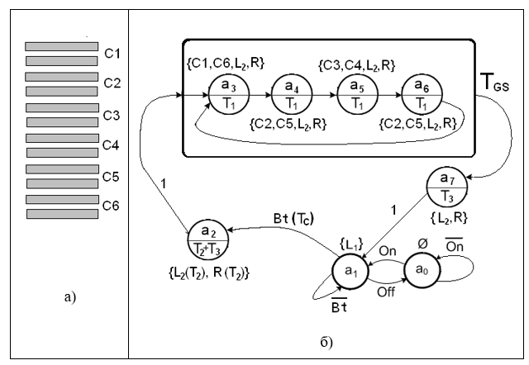
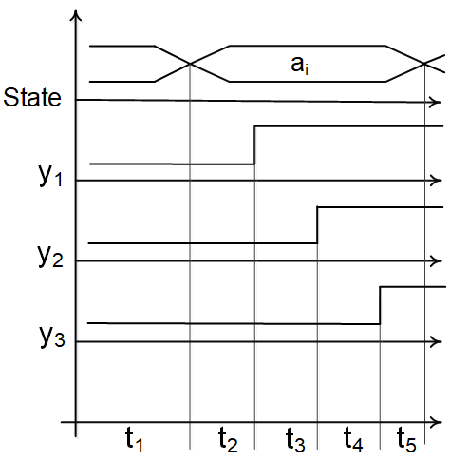
Standard template for software implementation of the control device
1
2
1 - Control device model
2 - Time chart of a standard template
Notes:
The logic of describing an automatic template based on a microcontroller is almost identical to the description of an HDL model. There are a few differences.
Another programming language (C / C ++).
Use of already implemented internal peripherals (I / O ports, timers, ADCs, etc.).
Use of event / interrupt model principles and use of interrupt handlers.
Additional internal signals (variables) to communicate with interrupt handlers. Additional variables preserve the construction of the template according to the logic of division into the function of transitions-outputs and the function of delays.
/ * How the device works on the graph * /
/ * Why is the chart a standard template? * /

Slide 12
Standard Template Initialization
/*All the LEDs that locates in LED control block*/
#define BTN_LIGHT GPIO_PIN_3
#define RED_LIGHT GPIO_PIN_4
#define LIGHTER GPIO_PIN_5
#define C1 GPIO_PIN_6
#define C2 GPIO_PIN_7
#define C3 GPIO_PIN_8
#define C4 GPIO_PIN_9
#define C5 GPIO_PIN_10
#define C6 GPIO_PIN_11
/*Allow to process the BTN pushing*/
#define BTN_READY HAL_NVIC_EnableIRQ(EXTI2_IRQn);
/*Forbid the BTN pushing processing*/
#define BTN_NOT_READY HAL_NVIC_DisableIRQ(EXTI2_IRQn);
/*CHECK if the system is ON/OFF*/
#define BUTTON_ON HAL_GPIO_ReadPin(GPIOA, GPIO_PIN_1);
/*CHECK if the btn is pushed*/
#define BTN HAL_GPIO_ReadPin(GPIOA, GPIO_PIN_2);
/*States definition with numbers coding (0-7)*/
typedef enum {a0,a1,a2,a3,a4,a5,a6,a7} States;
/*All delays in ms (0-6 + DELAYS_COUNT that shows the count of delays)*/
typedef enum {T0,T1,T2,T3,Tb,Tc,DELAYS_COUNT}Delays;
//Array with a delay values
//
uint16_t delays[DELAYS_COUNT] = {1000,3000,5000,5000,101,30000};
/*
Special variable for delay function to execute the transition
a5-a4-a3-a6
volatile specificator tells the program that
the variable value can be changed in another part of main program
(e.g.interrupts)but the main cycle will know it
*/
volatile uint16_t walkTime;
volatile States state = a0; //Current state
States nextState; //Next state
Notes:
The software implementation of the control device is divided into two files. The * .h header file, which contains macros, and the * .c extension file, which contains all the necessary variables for implementation and the basic functions of the automatic template.
The macro instructs the compiler to create an alias that is used to describe various data. This approach is fully used in project generation in places where the developer, for example, does not need to know the code of the pressed button, but needs to know exactly which button was pressed. You can also use a macro to override a function call.
In the software implementation, macros are used to name the output signals, call the function that checks whether the button is pressed, and enable or disable interrupts.

Slide 13
Standard template. States and delays.
Software implementation of transition initiation
//A special checkers for each pushed/unpushed button //in system
//
volatile uint8_t isButtonOnPushed;
volatile uint8_t isBtnPushed;
//Timer interrupt handler(callback)
//
void HAL_TIM_PeriodElapsedCallback(TIM_HandleTypeDef *htim)
{
//Delays function
//
…
//Interrupt handler for BUTTON_ON and BTN
//
else if(htim->Instance == TIM4)
{
if(BUTTON_ON == ON)
{
isButtonOnPushed = !isButtonOnPushed; //Change the value of
pushing (like a toggle)
}
else if (BTN == ON)
{
isBtnPushed = 1;
}
else
{
isButtonOnPushed = 0;
isBtnPushed = 0;
}
HAL_TIM_Base_Stop_IT(&htim4); //Stop the timer work
for buttons
}
}
//Pushing button interrupt handler(callback)
//
void HAL_GPIO_EXTI_Callback(uint16_t GPIO_Pin)
{
if(GPIO_Pin == GPIO_PIN_1 || GPIO_Pin == GPIO_PIN_2) //Check the correct pin (btn pin) for insurance
{
HAL_TIM_Base_Start_IT(&htim4); //Allow the timer working for buttons
}
}
Notes:
Interruption from an external event at the touch of a button plays an important role in the operation of the system. First, there is the elimination of pressing the button for the entire time the system is in a certain state (the user does not know how long it is). Secondly, it includes a configured event / interrupt handling system.
/ * About variables and handler from button * /
/ * About the handler from the timer with a delay of 101 ms * /
For the user's awareness that the transition was initiated, the button is illuminated by an LED.

Slide 14
Standard template. Output function. Hyperprocess
//Transitions function
//
switch(state)
{
case a3:
if(walkTime >= delays[T1]*4) /*Check the time in hyper process and select the right next state*/
{
nextState = a7;
}
else
{
nextState = a4;
}
break;
case a4:
nextState = a5;
break;
case a5:
nextState = a6;
break;
case a6:
nextState = a3;
break;
…
}
switch(state) /*Outputs function*/
{
…
/*Hyper States outputs blocks*/
case a3:
HAL_GPIO_WritePin(LEDS,C1|C6,ON);
HAL_GPIO_WritePin(LEDS,C2|C5,OFF);
HAL_GPIO_WritePin(LEDS,C3|C4,OFF);
break;
case a4:
HAL_GPIO_WritePin(LEDS,C1|C6,OFF);
HAL_GPIO_WritePin(LEDS,C2|C5,ON);
HAL_GPIO_WritePin(LEDS,C3|C4,OFF);
break;
case a5:
HAL_GPIO_WritePin(LEDS,C1|C6,OFF);
HAL_GPIO_WritePin(LEDS,C2|C5,OFF);
HAL_GPIO_WritePin(LEDS,C3|C4,ON);
break;
case a6:
HAL_GPIO_WritePin(LEDS,C1|C6,OFF);
HAL_GPIO_WritePin(LEDS,C2|C5,ON);
HAL_GPIO_WritePin(LEDS,C3|C4,OFF);
break;
/*END Hyper States outputs blocks*/
…
}
Notes:
/ * On the transition from state a2 to hyperprocess * /
/ * The hyperprocess is infinite, but the exit condition must be. This is the time that the hyperprocess works in general (in the transition function variable walkTime) * /
/ * Hyperprocess time - the sum of all hyperstate delays * /
/ * Recall that duplication of states (a4 and a6) should be for the closure of the hyperprocess and the exclusion of unfeasible transitions * /

Slide 15
Standard template. Restrictions window
void StateTransition()
{
…
switch(state) /*Outputs function*/
{
case a7:
HAL_GPIO_WritePin(LEDS,C1|C6,OFF);
if(__HAL_TIM_GET_COUNTER(&htim3) > delays[T3])
{
HAL_GPIO_WritePin(LEDS,RED_LIGHT|LIGHTER,OFF);
//COPY of a1 state that shows the ability to push the btn in a //constraint time to the next state transition
//
if(isBtnPushed == 0)
{
BTN_READY;
HAL_GPIO_WritePin(LEDS,BTN_LIGHT,ON);
}
else
{
BTN_NOT_READY;
HAL_GPIO_WritePin(LEDS,BTN_LIGHT,OFF);
}
}
break;
…
}
}
Notes:
/ * Implementation of the largest delay - constraint window * /
/ * About duplication of the functionality of the state a1, which corresponds to the ability to press the button earlier and wait for the transition (button oversight effect) * /

Slide 16
Standard template. Delay function
void HAL_TIM_PeriodElapsedCallback(TIM_HandleTypeDef *htim) //Timer interrupt handler(callback)
{
//Delays function
//
if(htim->Instance == TIM3)
{
HAL_TIM_Base_Stop_IT(&htim3); //Stop the timer and forbid the interrupt (for insurance)
uint16_t delayMs = 0; //Variable for keeping the chosen delay
state = nextState; //Transition execution
if(state == a0 || state == a1)
{
delayMs = delays[T0];
}
…
else if(state == a2)
{
delayMs = delays[T2]+delays[T3];
}
…
else if(state == a3 || state == a4 || state == a5
|| state == a6)
{
delayMs = delays[T1];
walkTime += delays[T1];
}
else if(state == a7)
{
delayMs = delays[T3]+delays[Tc];
walkTime = 0;
}
else //for insurance to avoid the exceptions
{
delayMs = delays[T0];
}
__HAL_TIM_SET_AUTORELOAD(&htim3, delayMs); //Reload the necessary timeout to the timer register
//The correct way in interrupt handling
//is the stop and start the timer again (including //interrupt handling)
//
HAL_TIM_Base_Start_IT(&htim3);
}
…
}
Notes:
/ * The heart of all transitions * /
/ * Also implemented as an interrupt * /
/ * One interrupt handler for different timers? Callback (in terms of programming, no duplication of code and the use of other files in describing the software implementation). In terms of implementation - no need to control the system flags of events and interrupts * /

Slide 17
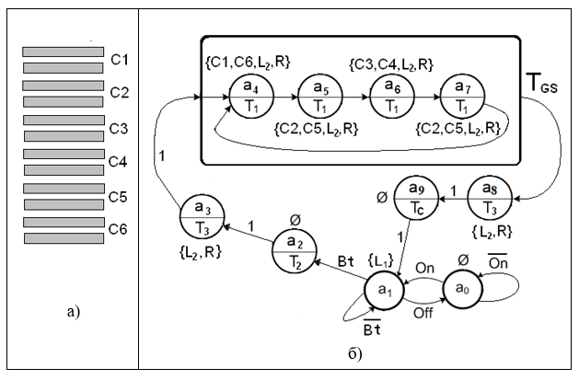
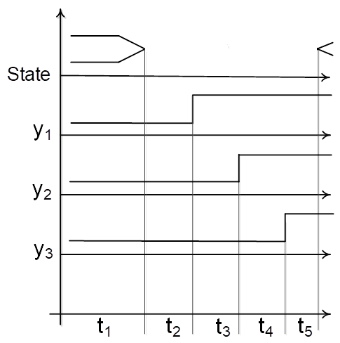
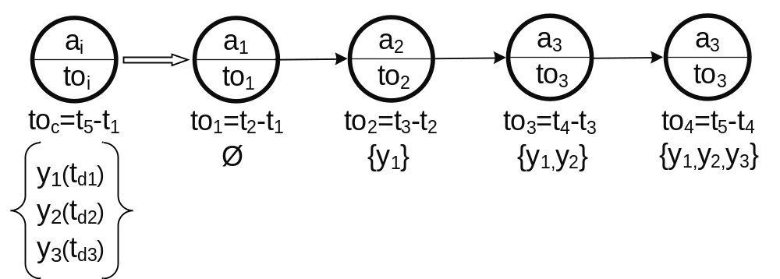
Alternative scenario for describing a device with "splitting states"
3
1
2
1 - Model of the control device
2 - "Splitting states"
3 - Time diagram "splitting states"
Notes:
However, as always, there are some alternatives. With regard to the implementation of the automatic template on the MCU, you can abandon some principles, saving some memory or reduce interference in the system part of the MCU.
The main difference between the model of the control machine is the elimination of the delay at the output. On the one hand, such an implementation somewhat violates the principle of an automatic template for describing a real-time system. But on the other hand, there is a more important feature of such systems - the division of responsibilities. That is, each state can be considered as a specific task performed by the device. As a rule, one task must perform one specific action or several related actions. For example, one task is responsible for reading data and sending it to the second task. The second task, based on the read data, forms a graph and transfers the graph data to the third task. The third task displays this graph.
However, it should be noted that this description, looking at the mechanism of division of responsibilities, has more states than the standard template. This mechanism is called state splitting.
Sometimes there is a situation when the state may not have certain actions, but according to the logic of excluding delays at the exit must be implemented (every state that has a delay at the exit must be split). Such states are called "idle". Their main task is to delay the time of inclusion of certain signals in the next state.

Slide 18
Description of "splitting states"
Output function
switch(state) /*Outputs function*/
{
…
case a2:
/*
*An idle state where the outputs may not be described
*This is a key point of state splitting mechanism to exclude the output delays
*But for supporting the description of the template, the outputs should be described
*In this case the BTN and the BTN interrupt are not available
*/
isBtnPushed = 0;
BTN_NOT_READY;
break;
case a3:
HAL_GPIO_WritePin(LEDS,RED_LIGHT|LIGHTER,ON);
break;
…
}
//The vivid example of a transition splitting to hide the
//output delays meaning (a8 and a9)
//
case a8:
HAL_GPIO_WritePin(LEDS,C1|C6,OFF);
break;
case a9:
HAL_GPIO_WritePin(LEDS,C1|C6,OFF);
HAL_GPIO_WritePin(LEDS,RED_LIGHT|LIGHTER,OFF);
//COPY of a1 state that shows the ability to //push the BTN in a constraint time to //the next state transition
//
if(isBtnPushed == 0)
{
BTN_READY;
HAL_GPIO_WritePin(LEDS,BTN_LIGHT,ON);
}
else
{
BTN_NOT_READY;
HAL_GPIO_WritePin(LEDS,BTN_LIGHT,OFF);
}
break;
…
Notes:
Briefly about the code on the slide
And in the function of transitions the unconditional transition from state to state is realized.

Slide 19
Description of "splitting states" Delay function
//Timer interrupt handler(callback)
//
void HAL_TIM_PeriodElapsedCallback(TIM_HandleTypeDef *htim)
{
//Delays function
//
if(htim->Instance == TIM3)
{
…
else if(state == a2)
{
delayMs = delays[T2];
}
else if(state == a3)
{
delayMs = delays[T3];
}
…
else if(state == a8)
{
delayMs = delays[T3];
walkTime = 0;
}
else if(state == a9)
{
delayMs = delays[Tc];
}
…
}
}
Notes:
The delay function also varies with the number of states. Each state is assigned its own delay without summation and other arithmetic operations with delays stored in the corresponding array.

Slide 20
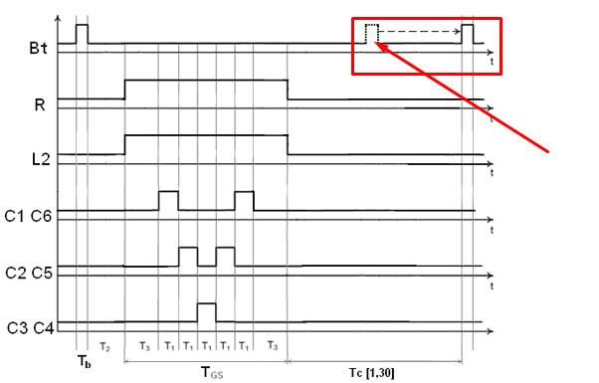
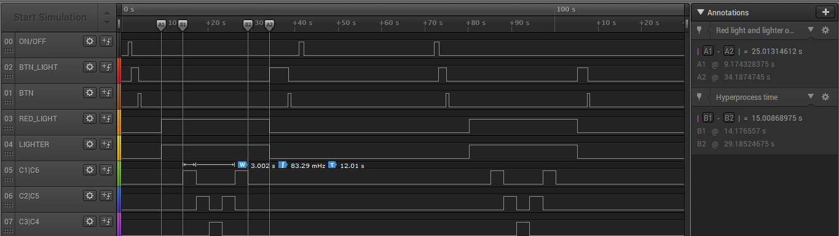
Simulation of device operation
Comparison of time charts, simulated manually and in real time, confirms the correct operation of the control device
The disadvantage of the real-time simulated timing chart is the lack of display of the current state, the next state and the clock signal
Notes:
The principle of operation of the device can be graphically represented by the timing chart shown above.
Manual simulation helps to determine the operation of the system as a whole with real signals at an early stage of design.
The result of the device operation on the implementation of two variants of the automatic template on the MC is shown in the timeline below, which is generated in real time, ie in parallel with the device operation, using hardware debugging using a logic analyzer.
The hand-modeled waveform highlights a situation that occurs in the constraint window state and can only be executed after transitioning to state a1. Note that time charts, as usual, should also show the current and next state of the machine. This is stated in the next slide.

Slide 21
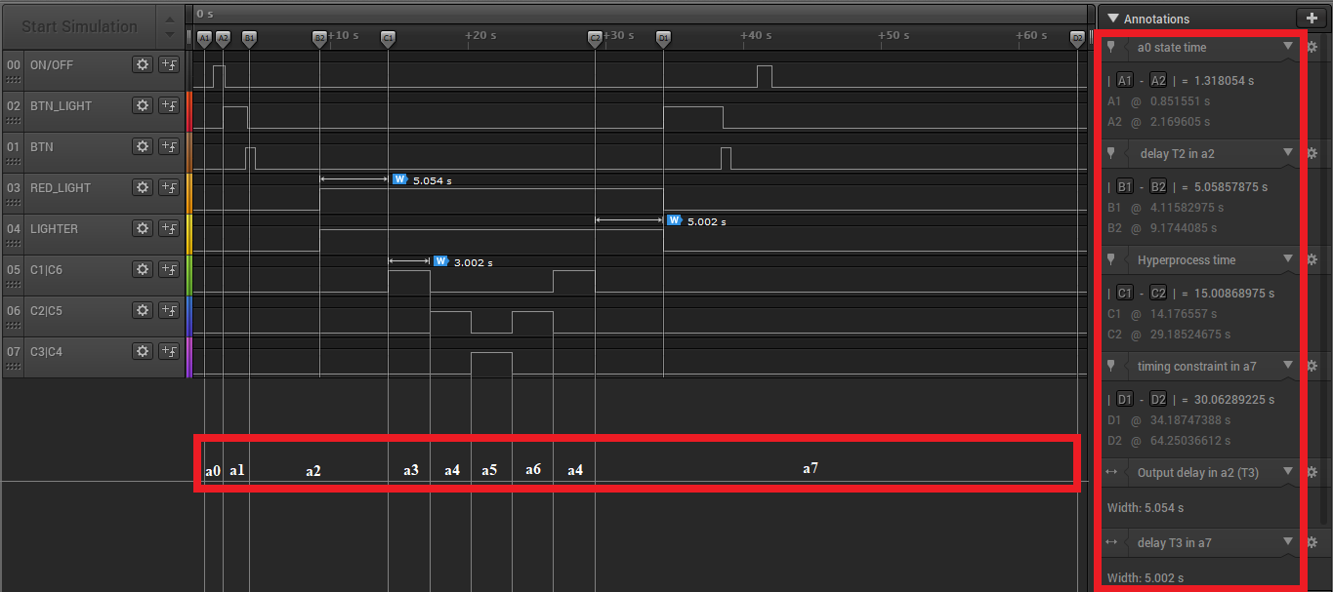
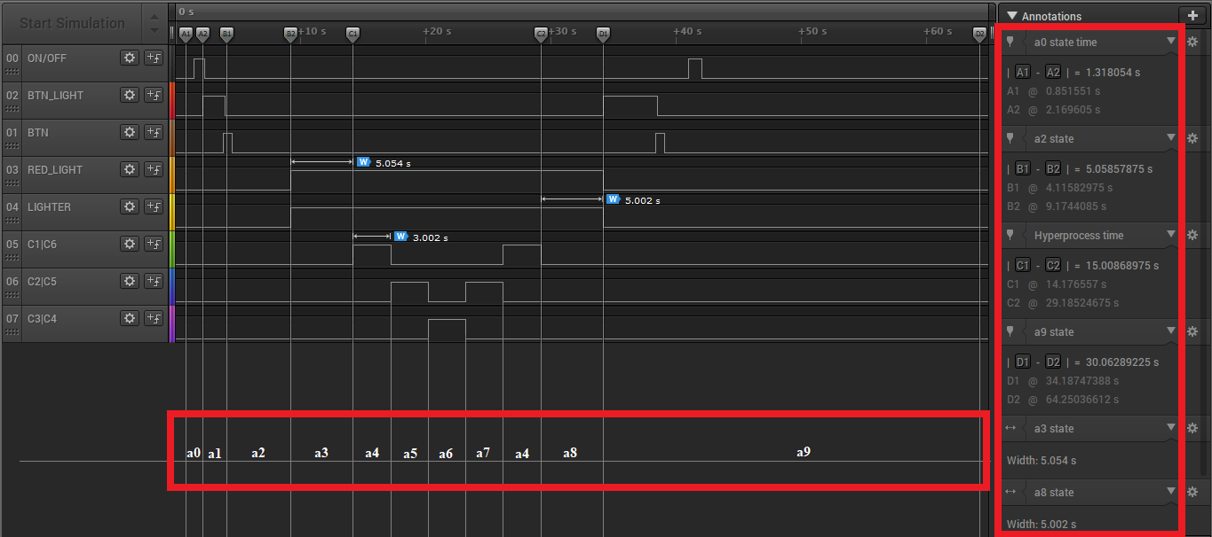
Comparison of device operation according to software implementation templates
Timing diagram of the device according to the implementation of the standard automatic template
Time diagram of the operation of the device by implementation
automatic template
with the splitting of states
Notes:
This slide shows time diagrams of the operation of the developed system for the implementation of the scenarios under consideration.
The state display is adjusted manually because the variables that store the current state and the next internal state are not related to the I / O peripherals. In addition, if they were connected, it would be necessary to further implement the data transfer protocol, which is not the main function of the system as a whole.
This comparison shows that the timing chart is the same for all implemented templates. All time characteristics are the same for each implementation (despite the "splitting of states"). The main difference is the display of the appearance of high or low signal level on the states of automatic templates.

Slide 22

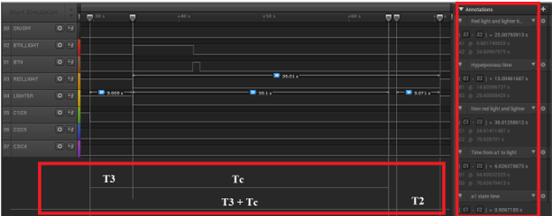
"Imaginary transfer" of the signal in the actual operation of the device
Image of "imaginary transfer" of the signal
How it really happens
Notes:
A few slides back I noticed the transfer of the Bt signal in the timeline, which is modeled manually. Of course, "imaginary" images on a real waveform cannot exist. How does this really happen?
This slide shows the situation when the system is in a state with a constraint window. The user presses the button to initiate the transition, but the reaction of the system should occur only after the end of the time of the restriction window, the transition to state a1 in which it will be checked whether the button was pressed.
From the point of view of the implemented system, this behavior of the system allows you to resume traffic for a while and at the same time prohibits the user from constantly pressing the button.

Slide 23
Comparative characteristics of templates
Standard template | Alternative template (splitting of states)
Strict adherence to the implementation of all delays | Exclusion of the concept of delays of initial values
Continuous polling of the system timer for the time remaining until the end of a certain delay | The mechanism of "split states",
Combination of several tasks of the same type in one state | Implementation of the principle of division of responsibilities
The presence of arithmetic operations in the delay function to form the total delay state | Creating multiple "idle" states
Increasing the calculation speed due to delays in the initial values | Exclude any logical conditions and arithmetic operations when working with time parameters (with variables that retain the delay or with system parameters)
Notes:
The slide shows a comparative description of the templates by their most noticeable features.
Some features are mutually exclusive in templates.
A very interesting question is how to choose a template. This question has no answer, because the use of a template is in the database of developer solutions. He decides which template to use "to your liking" (meaning the programming style).

Slide 24
Conclusions
The concepts of logic control systems, real-time systems and time machines are considered in detail. The method of their use in microcontroller systems is analyzed.
The principles of automatic programming in accordance with the peculiarities of the implementation of devices on the microcontroller (compatibility with the system of events / interrupts) are considered in detail
Based on the entire analysis, an automatic template for microcontroller systems was created, which meets all the criteria of real-time systems.
A microcontroller control device for pedestrian crossing lighting based on a state machine with the considered ones has been developed.
The concept of an automatic template for microcontroller systems was used in the development of the microcontroller device. The software implementation has two scenarios (templates): standard and alternative.
The standard template corresponds to all time parameters that are embedded in the concept of time machines (implemented output delays, state delays and constraint window). An alternative template eliminates the concept of output delays, due to the mechanism of splitting states, which leads to the use of the concept of separation of responsibilities (each state is a specific task).
The result of real-time implementation of the implemented system with the help of hardware debugging with the help of logic analyzer is considered and analyzed.
Notes:
This slide shows the general conclusions of the certification work and research on the example of the implementation of the logic control system and real-time system on the principles of automatic programming.
/ * Thank you for the attention of the commission and all present * /
/ * Suggest a little discussion * /

